Slide 1
Digital Rights Management in a 3G Mobile Phone and Beyond
Thomas S.Messerges, Ezzat A. Dabbish
ILKOO LEE

Slide 2
Contents
Introduction
DRM Concepts and strategies
Our DRM system
DRM Manager
Trusted Application Agents
Security Agent
DRM Credential
Security issues
Family Domain
Conclusion

Slide 3
Introduction
3G Mobile Phone
High communication rates (144 Kbps ~2 Mbps )
Personal Area Networking capability
P2P sharing of digital items over short-range networks
High Internet Connectivity
Business opportunities for digital contents are attracting much interest
Losses from piracy
Digital Rights Management(DRM) will be an essential component for future mobile phones

Slide 4
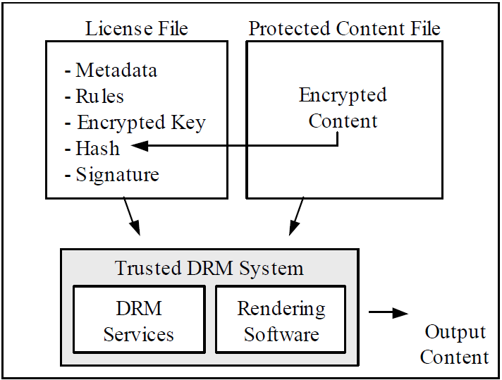
DRM concepts and strategies - Trusted DRM system

Slide 5
DRM concepts and strategies - Trusted DRM system
License File
Metadata
Usage Rules
Content Encryption Key (CEK)
Hash
Digital Signature
For authenticity and integrity
Protected Content File
Encrypted with CEK
Trusted DRM System
DRM Service
Verify the signature & the hash of content
Decrypt the content
Rendering Software (When content is rendered)

Slide 6
DRM concepts and strategies - Open Mobile Alliance DRM
Open Mobile Alliance (OMA)
developing DRM standards for the mobile phone industry
released Version 1.0 DRM specification
Open Mobile Alliance DRM
Goal
Devise a consumer-friendly DRM standard
“Content files can be distributed to other devices, but that licenses to use this content must be obtained from a server called the right issuer”
In this paper, “Family Domain” approach is proposed
Distributed contents to all devices owned by a consumer
No need to acquire a new license for each transfer

Slide 7
DRM System - OS with DRM Extensions
How to interface the DRM and security S/W with the phone’s OS and applications
Two approaches of Schneck’s paper
Replace the I/O elements of OS with new modules
Hyperadvisor
This paper`s approach
The OS is extended to support DRM functionality
Access these extended system services through APIs
These extensions run in “privileged mode”
Applications run in “user mode”

Slide 8
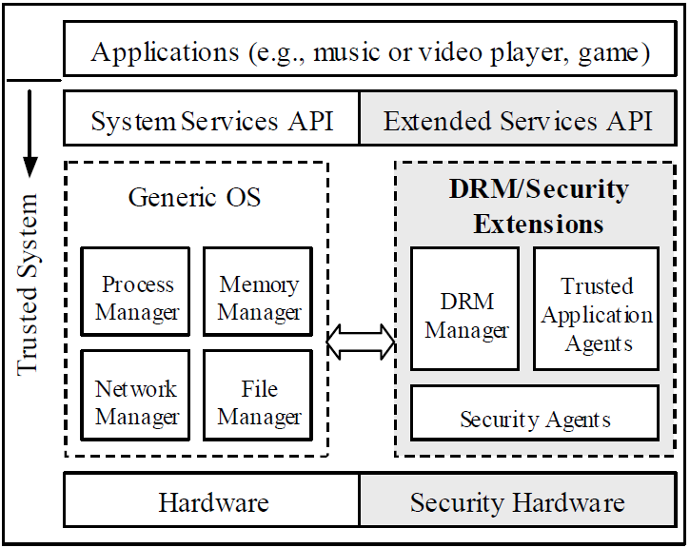
DRM System - OS with DRM Extensions

Slide 9
DRM System – DRM Manager
Authenticate Licenses and Content
Before use protected digital content
Need to verify the integrity and authenticity of the license file
Verify Cryptographic hash of the license file
Enforce Rights
Actions can be associated with three types of rights
Render rights ,Transport rights, Derivative work rights
Rights to an action are assigned to a device
Use device’s credentials (key/certificate manager)
Perform additional event for an action
Decrypt Content
Decrypt the content using key
Route it to a trusted application agent

Slide 10
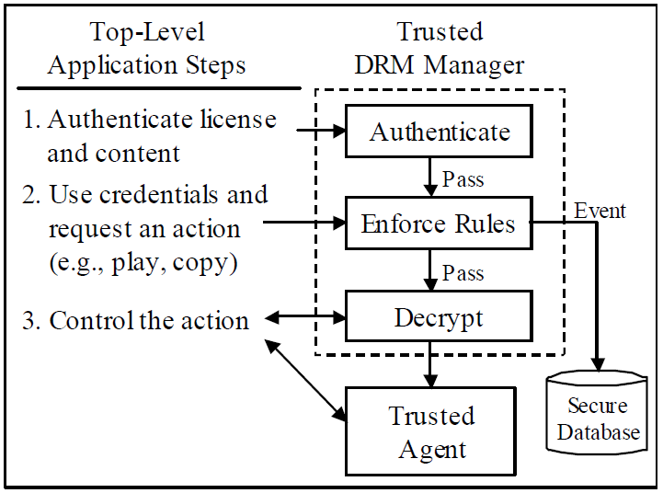
DRM System – DRM Manager

Slide 11
DRM System – Trusted Application Agents
Actually Access and manipulate decrypted content
Rendering Agents
Render DRM-protected content
Interact with top‐level GUI
Transport Agents
move content from one location to another
Establish a Secure Authenticate Channel(SAC)
Derivative Work Agents
Extract and transform protected content or license into a different form
Installation of DRM-protected software or data

Slide 12
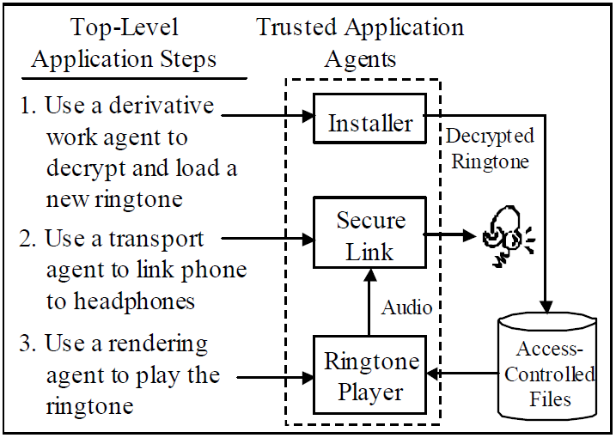
DRM System – Trusted Application Agents

Slide 13
DRM System – Security Agents
Memory and File management
Access-controlled file system
to store decrypted content
Memory separation system
To ensure that if a trusted operation is running, untrusted operations can’t eavesdrop on the memory
Secure memory system
To prevent critical data(private key) from leaking out of the system
Cryptographic operations
AES / SHA1 / RSA / ECC ...
Key/Certificate management
Securely handle a database of the phone’s credentials (keys, certificates, IDs)

Slide 14
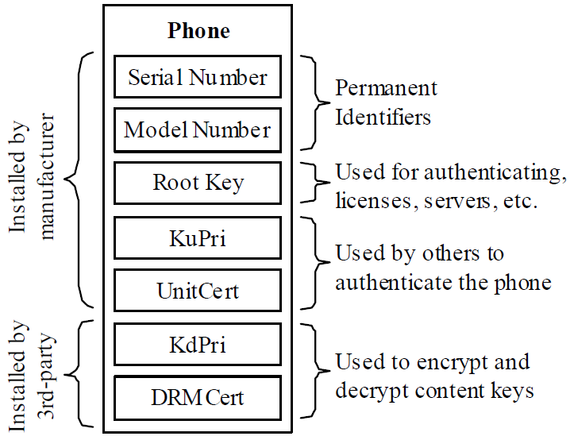
DRM System – DRM Credentials

Slide 15
DRM System – DRM Credentials
Serial Number
Unchangeable number that identifies the phone
Model Number
Number that identifies HW and SW version
Root Key
Check the authenticity and integrity of the credentials
Private keys and Certificates
KuPri and UniCert
Used for establishing Secure Authenticate Channel(SAC) to a phone
KdPri and DRMCert
Used for assigning content to a device
Content encryption key is encrypted with KdPub and decrypted with KdPri

Slide 16
Security Issues
Licenses
Need to verify integrity and authenticity of licenses
Integrity and Authenticity
Content providers need to trust that the DRM system will keep keys secret
Rights Enforcement
DRM manager should enforce rights responsibly and fail in a safe manner if there are conflicting constraints
Content Protection
Rendering software should be trusted to not leak of copy the decrypted content
Privacy Issues
User information and identity must not be disclosed

Slide 17
Family Domain
The consumers don’t want to be locked to one particular device
Consumer decides which devices belong to his domain
Portable devices are assigned to a particular domain by registering with the DA(Domain Authority)
A trusted server, DA installs common DRM private key in all these devices
Domain private key
A device needs to register with a DA once, and could access to all the content in a domain with domain private key

Slide 18
Example Use Cases
Enrollment of Device into a Family Domain
1. The consumer activates the domain enrollment application, which initiates contact with the DA.
2. The phone and DA establish a SAC and the device identifies itself to the DA.
3. The consumer indicates whether he wants to form a new domain or add the device to an existing domain.
4. The DA sends a new or an existing (in the case of joining an existing domain) KdPri and DRMCert to the phone.
5. The phone securely installs the KdPri into its accesscontrolleddatabase.

Slide 19
Example Use Cases
Enrollment of Device into a Family Domain
1. The consumer activates the domain enrollment application, which initiates contact with the DA.
2. The phone and DA establish a SAC and the device identifies itself to the DA.
3. The consumer indicates whether he wants to form a new domain or add the device to an existing domain.
4. The DA sends a new or an existing (in the case of joining an existing domain) KdPri and DRMCert to the phone.
5. The phone securely installs the KdPri into its accesscontrolleddatabase.

Slide 20
Example Use Cases
Content Rendering
1. The top-level application gives the name of the protected content and license files to the DRM manager, which uses the phone’s root key to authenticate the license.
2. The top-level application requests a “PLAY” action from the DRM manager, which enforces the usage rules and, if necessary, logs an event in the secure database.
3. The DRM manager invokes a trusted security agent to decrypt the content key CEK using the KdPri.
4. The top-level application controls the rendering agents, which decrypt, process, and send the content to an output device.
5. If any of the above steps fail or the requested right is not allowed, the content is not rendered and the top-level application is notified.

Slide 21
Example Use Cases
Peer-to-Peer Superdistribution
1. The top-level application gives the name of the protected content and license files to the DRM manager, which uses the phone’s root key to authenticate the license.
2. The top-level application requests a “PLAY” action from the DRM manager. The manager determines that the recipient’s credentials do not allow rendering. However, a short, decrypted sample may be included with the content.
3. The user is asked whether she wants to hear the short sample (if available) or purchase full rights to the content.
4. If the user wants to hear the sample, a trusted rendering agent is used to render the sample.
5. If the user wants to buy the full rights, a purchase transaction protocol is invoked and a new license is delivered over the air.

Slide 22
Conclusion
DRM framework is proposed for a mobile phone environment
Also applicable to other devices
PDA, tablet pc, automobile etc
DRM system
DRM Manager, Trusted Application Agents, Security Agents
Family Domain
Content could be more seamlessly shared amongst all devices owned by a consumer

